Slide 1
Mass-Spring-Simulation
2019-2 Interective Visualization PA#2
2016320189 이광렬

Slide 2
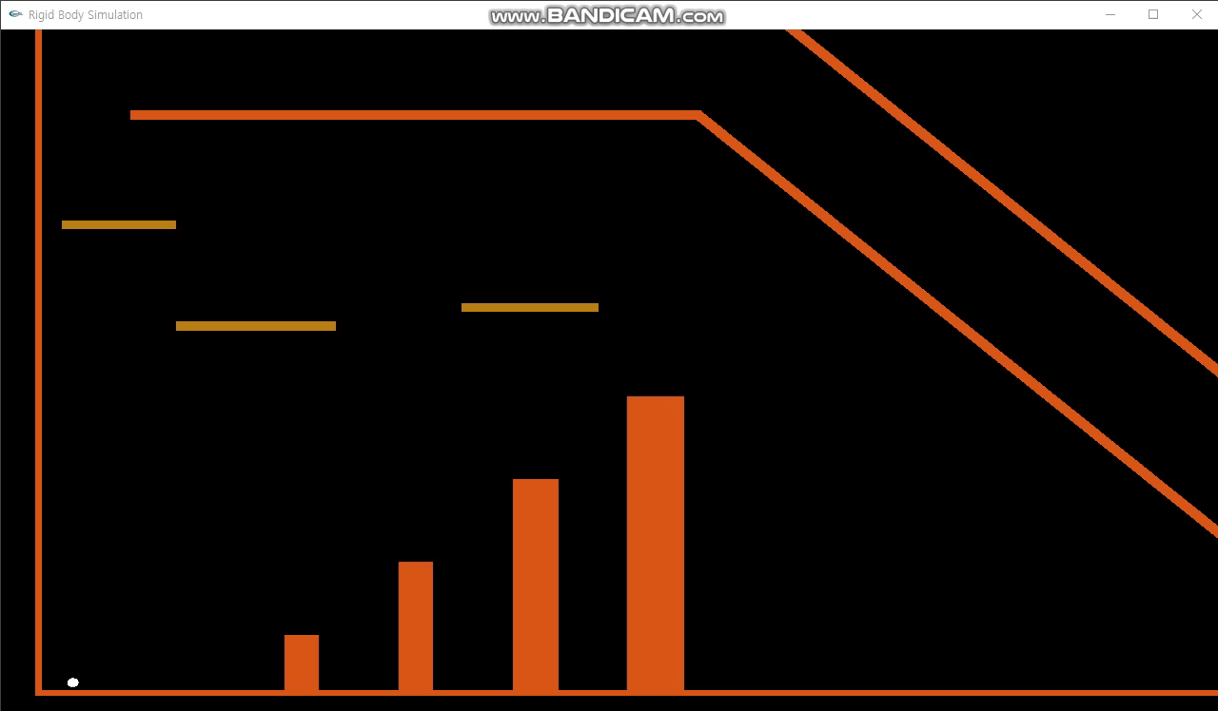
PA#1 Demo Video

Slide 3
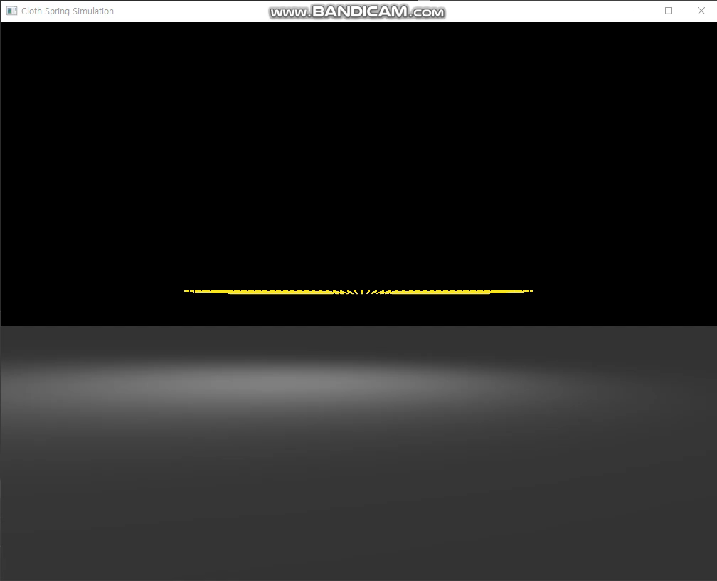
PA#2 Demo Video

Slide 4
구현 사항
기본 구현 사항
추가 구현 사항
Initialization
node spring face
Simulation
Force
Integration
Rendering
Normal
Collision
User Interaction
Bending spring
Sphere collision
Texture mapping

Slide 5
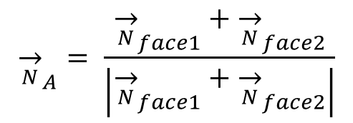

Face, Vertex Normal
D
A
$${\overset{→}{N}}_{face1} = \frac{\vec{AB}\text{×}\vec{AC}}{\left|\vec{AB}\text{×}\vec{AC}\right|}$$
Face 2
Face 1
$${\overset{→}{N}}_{A}= \frac{{\overset{→}{N}}_{face1}+{\overset{→}{N}}_{face2}}{\left|{\overset{→}{N}}_{face1}+{\overset{→}{N}}_{face2}\right|}$$
B
C

Slide 6
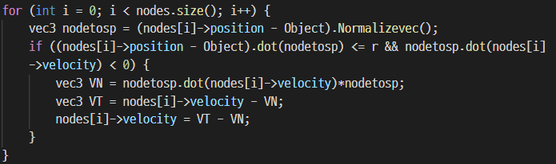
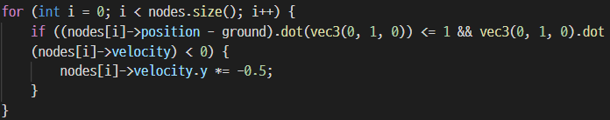
Collision-Response
Collision with ground
Collision with sphere

